Slide 1
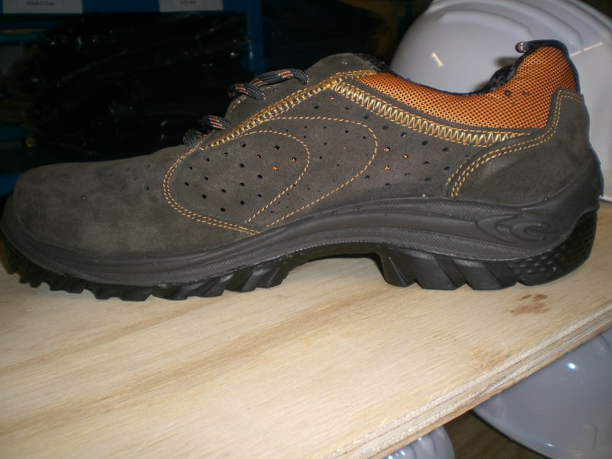

HS&E INCIDENT BULLETIN |  | 1st half year 2014
Location Country | Type of incident (example: Slip-Trip, Fall from Height, Vehicle , Laceration, Chemical Exposure)
Summary:
Climbing a ladder (1,5 mt.) the operator’s foot slipped (personal incident low potential)
Root Causes: | Actions Taken Thus Far: Next Steps
Bad weather condition Personal Protection Equipment inadequate | Change PPE (safety shoes with the same degree of protection but with recess into outsole)

